Slide 1
Structuring Industrial Security Standards for Machine-Readable Analysis
Dipan Banerjee
Notes:
1

Slide 2
Recap
2
Text Extraction
Extracted text as content from PDFs
Phase Classification
Mapped content to the lifecycle phases using NLP (TDIF, cosine similarity)
Metadata Design
Added extra columns like normative, keywords, abstraction level
Combined Table
Unified schema for both with vector embeddings for searchable corpus
Embeddings
Generated vector representations- to find out the similarity score.
Supabase storage
The results are stored in supabase
Notes:
2

Slide 3
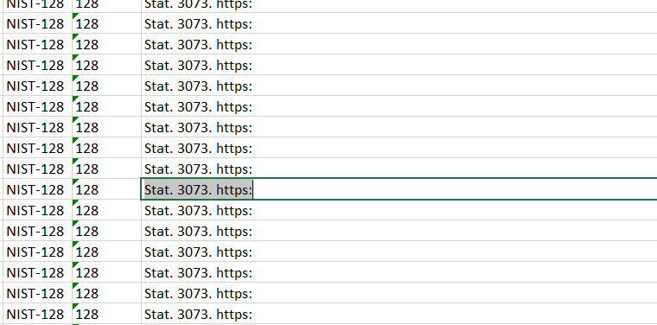
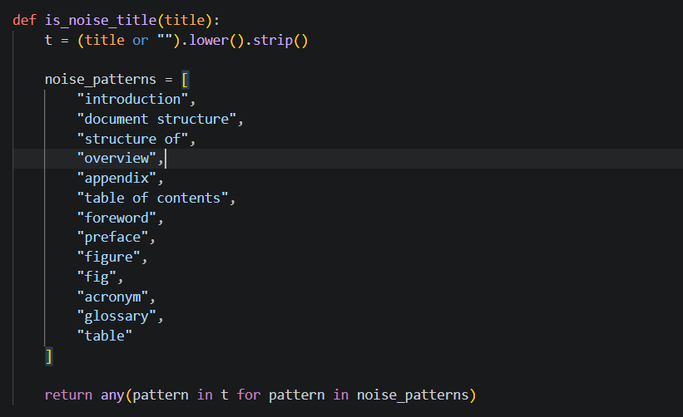
Challenges
3
Raw PDF text was not suitable for retrieval.
Chunking was difficult to tune.
* Also added 0.05 similarity for normative and lifecycle phase
Notes:
3

Slide 4
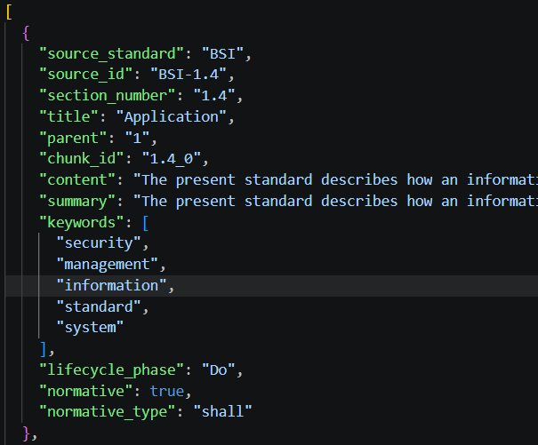
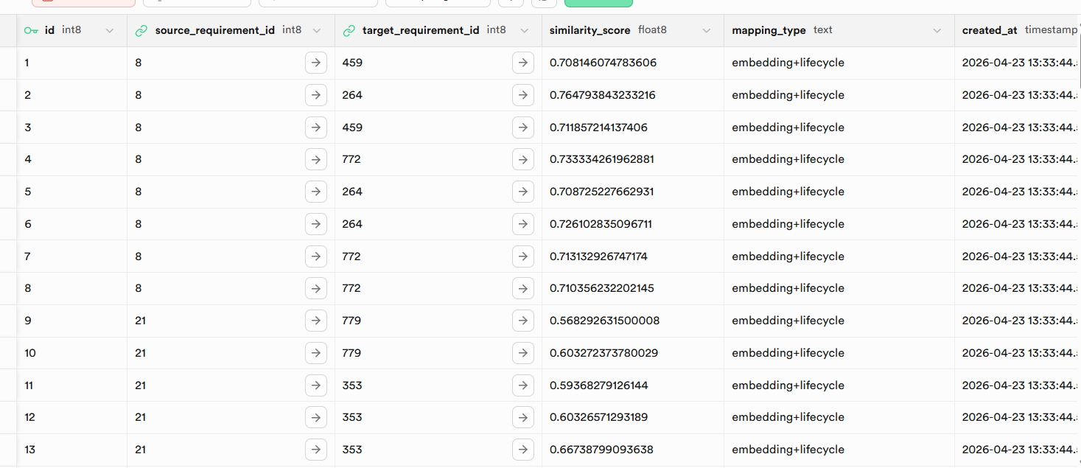
Database Now
4
Notes:
4

Slide 5
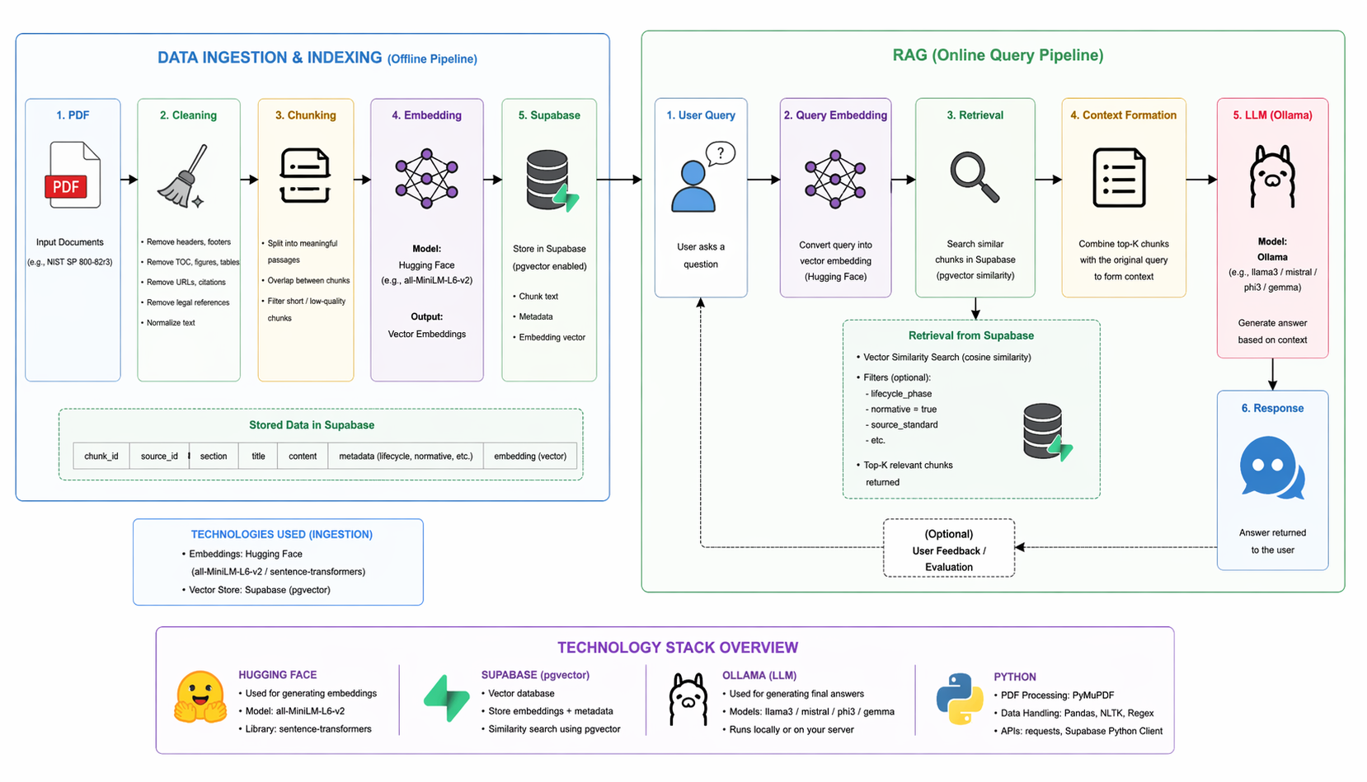
Improved Architecture
5
Notes:
5

Slide 6
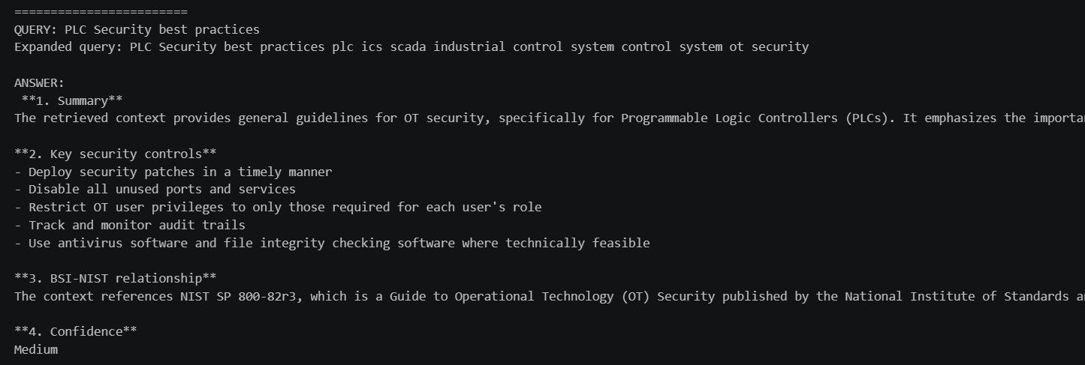
Results
6
07.11.2019
Notes:
6

Slide 7
Topics of Discussion
7
How to prepare the gold standard dataset.
Next task probably with streamlit applications
Will be using paid source gpt model or perplexity and their embeddings rather than open source.
Since LLM is performing technically well but semantically it can be problematic , it can reduce the precision and recall score overall.
Notes:
7

Slide 8
8
Thank you
Notes:
8

